Slide 1

Python

Slide 2
Python is a powerful, flexible, and beginner-friendly language.
It powers AI, web apps, automation, data science, and more.
Constantly evolving with strong community and open-source support.
A must-learn language for modern developers.

Slide 3
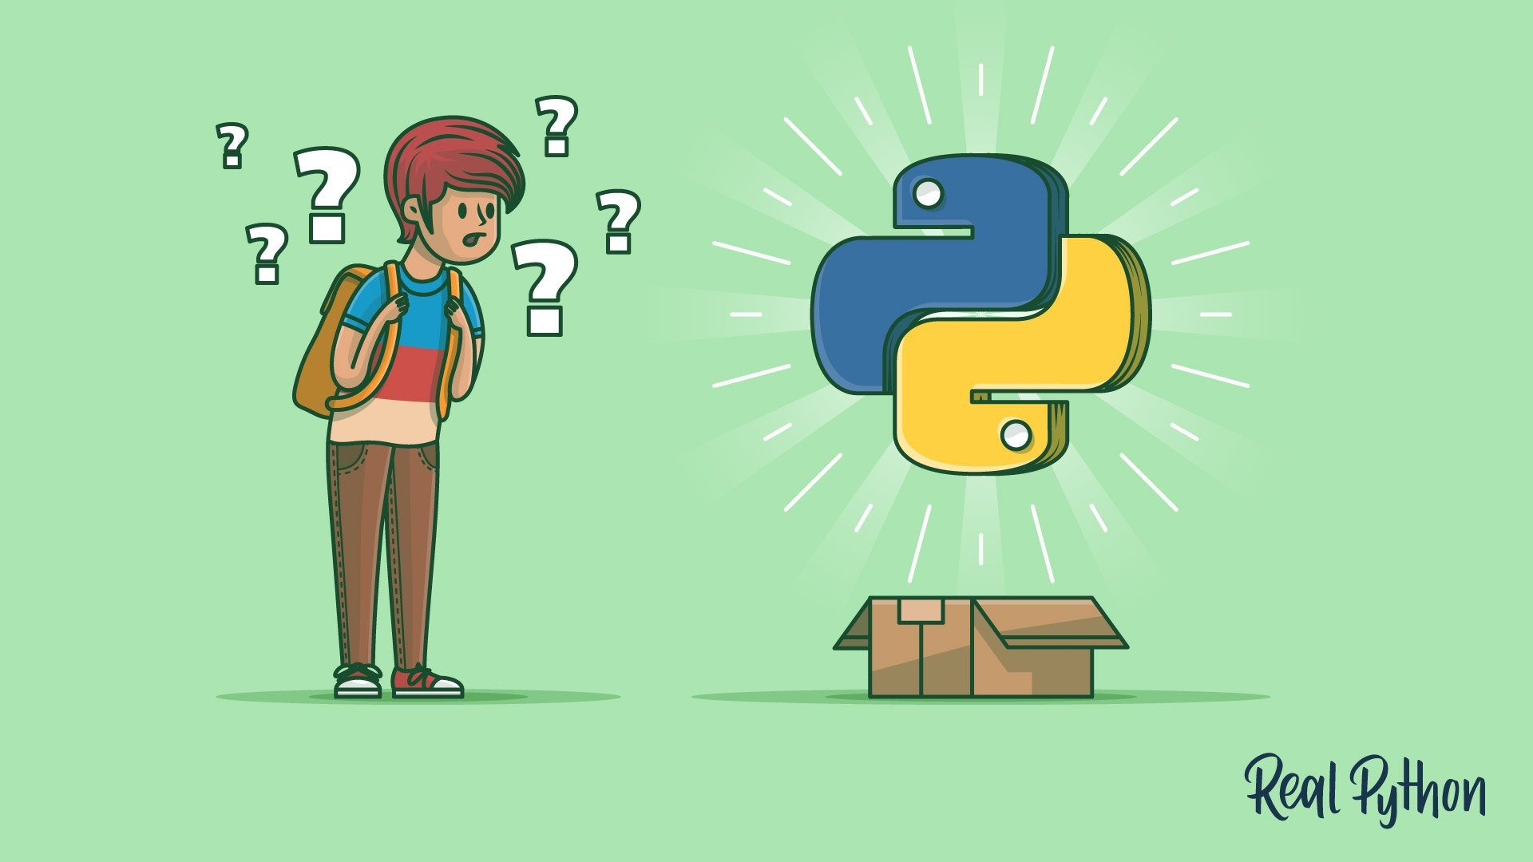
Why Students Should Start with Python
Smooth learning curve for beginners.
Encourages experimentation and creativity.
Strong foundation for learning other languages later.
Plenty of free tools, tutorials, and projects available.

Slide 4
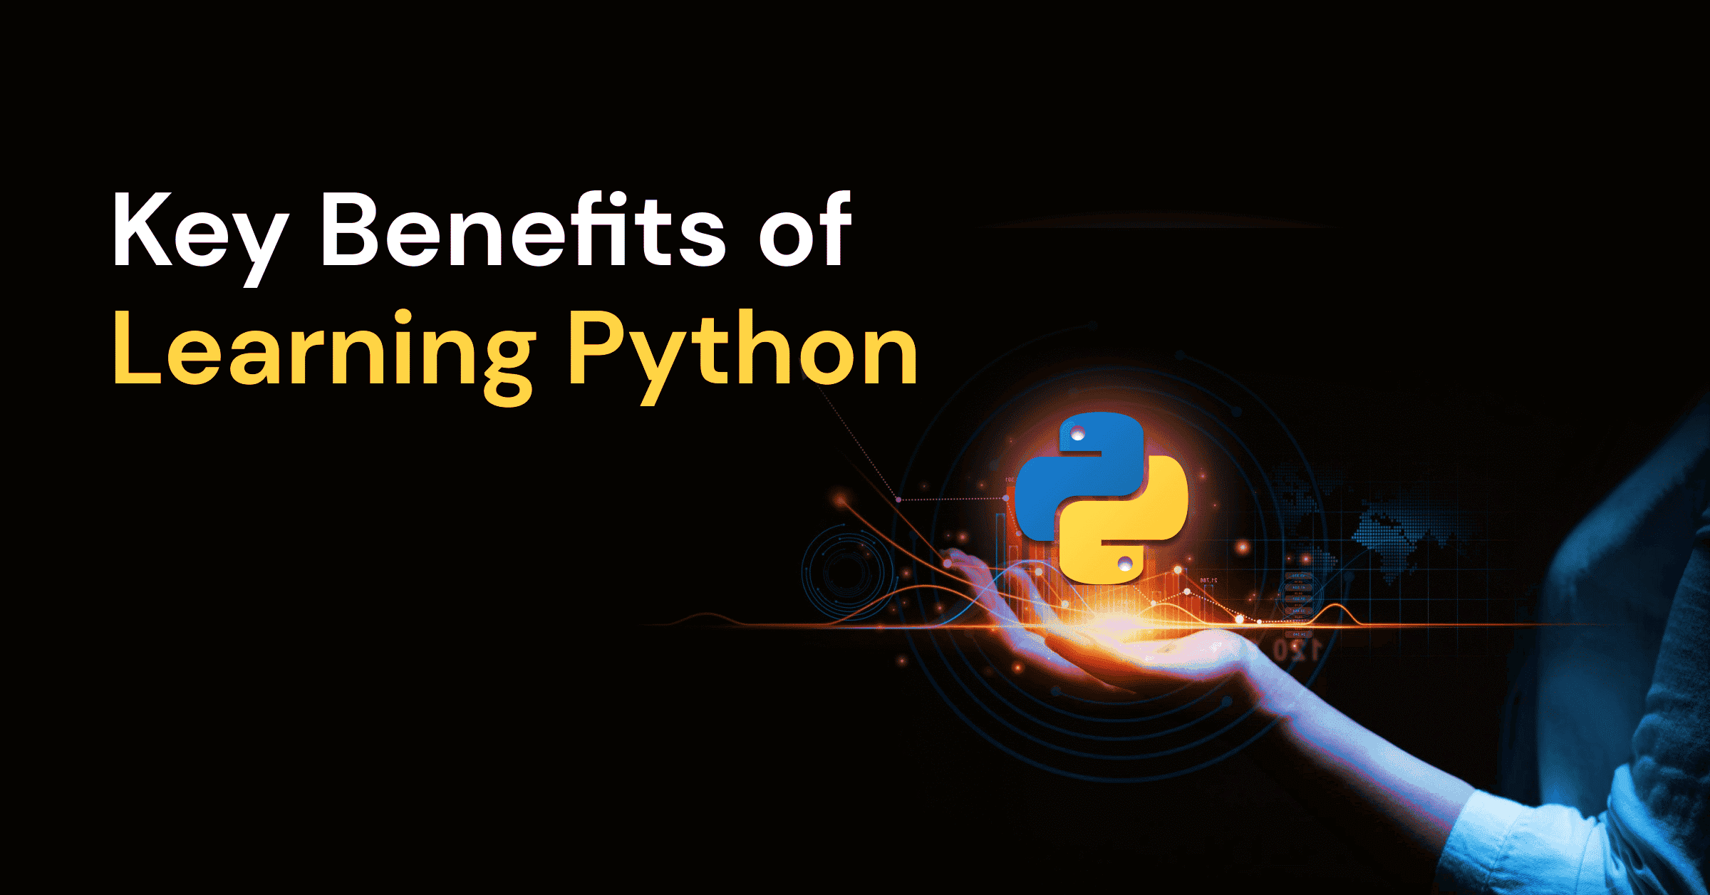
💡 For Students:
Great first programming language.
Builds strong logic and problem-solving skills.
Huge learning resources and tutorials available online.
💼 For Professionals:
Highly in-demand skill in the tech job market.
Used by top companies (Google, Netflix, YouTube, NASA, IBM).
Opens doors to careers in:
Data Science
Machine Learning / AI
Web Development
Cybersecurity
Automation
Software Testing

Slide 5
COMPARISON WITH OTHER LANGUAGES
Feature | Python | Java | C++
Ease of Learning | ⭐⭐⭐⭐⭐ | ⭐⭐⭐ | ⭐⭐
Execution Speed | ⭐⭐ | ⭐⭐⭐⭐ | ⭐⭐⭐⭐
Libraries | ⭐⭐⭐⭐⭐ | ⭐⭐⭐⭐ | ⭐⭐⭐
Community Support | ⭐⭐⭐⭐⭐ | ⭐⭐⭐⭐ | ⭐⭐⭐
Syntax Simplicity | ⭐⭐⭐⭐⭐ | ⭐⭐ | ⭐

Slide 6
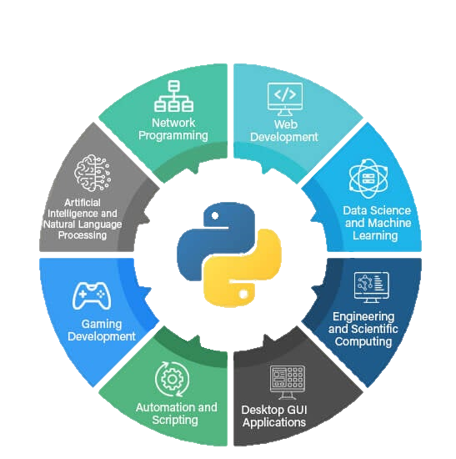
Python Applications
Web Development: Django, Flask
Data Analysis: Pandas, NumPy
Machine Learning: scikit-learn, TensorFlow, PyTorch
Automation: Selenium, Script automation
Game Development: Pygame
IoT and Robotics: Raspberry Pi

Slide 7
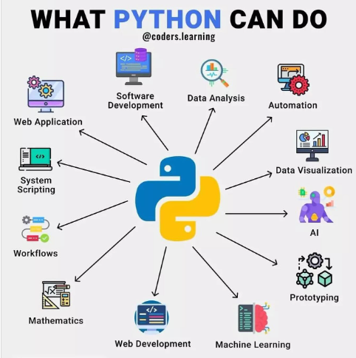

Slide 8
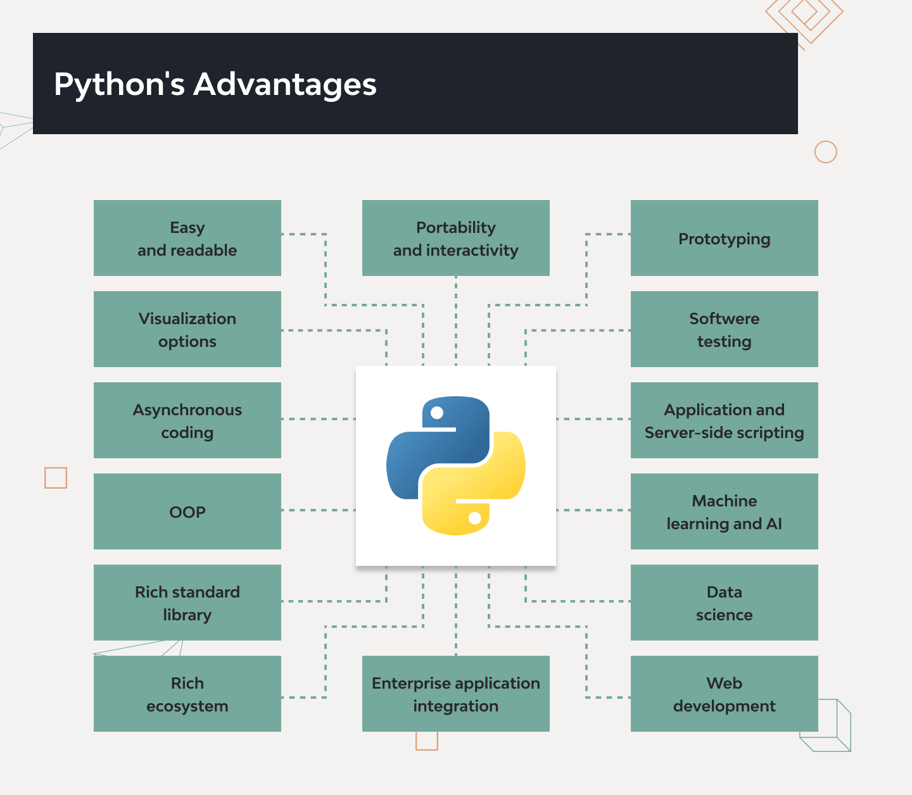

Slide 9
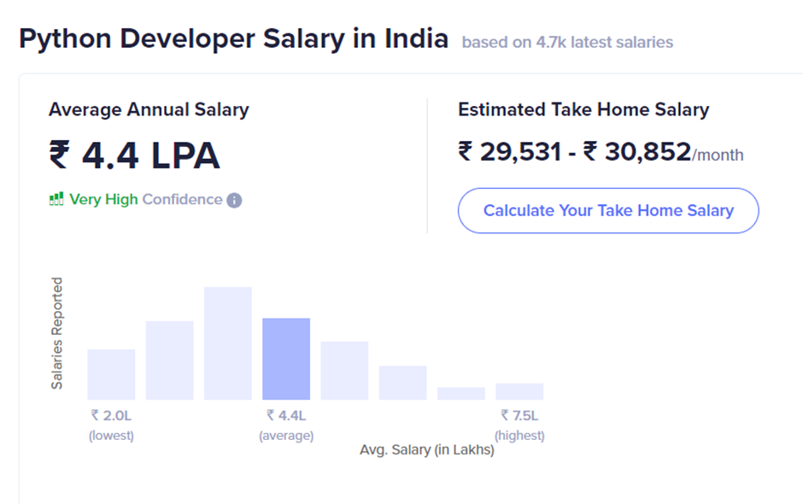
Python in the Job Market
📈 Python consistently ranks in the Top 3 most used programming languages (TIOBE Index, Stack Overflow surveys).
Used by major tech giants: Google, Facebook, Microsoft, Amazon, Tesla.
Average salaries (approx.):
Python Developer: $80,000–$130,000/year (USD)
Data Scientist (Python): $100,000+
Common job roles:
Python Developer
Data Analyst / Data Scientist
Machine Learning Engineer
Backend Developer
Automation Engineer

Slide 10
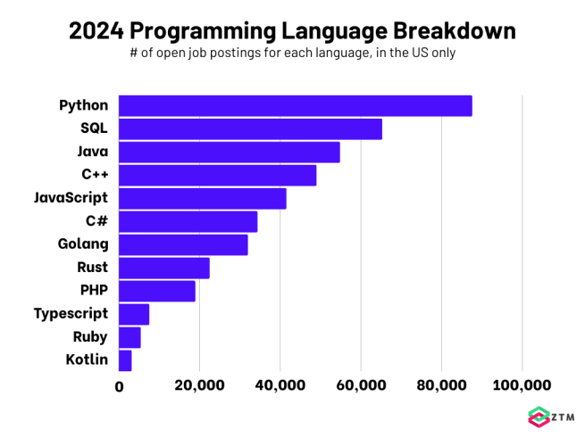

Slide 11
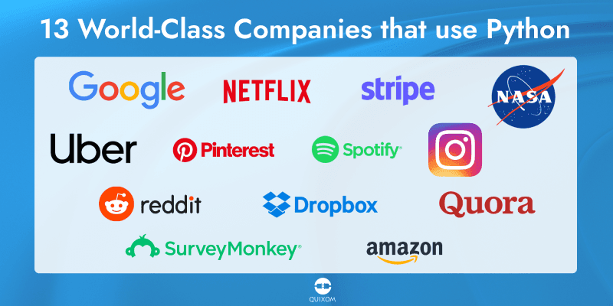

Slide 12
Real-World Use Cases
Industry | Example | Python Use
Web Apps | Instagram, Reddit | Django, Flask frameworks
AI/ML | Google, OpenAI | TensorFlow, PyTorch
Data Science | Netflix, Spotify | Pandas, NumPy
Automation | IT & Finance | Scripting repetitive tasks
Education | Schools, Universities | Teaching and Research

Slide 13
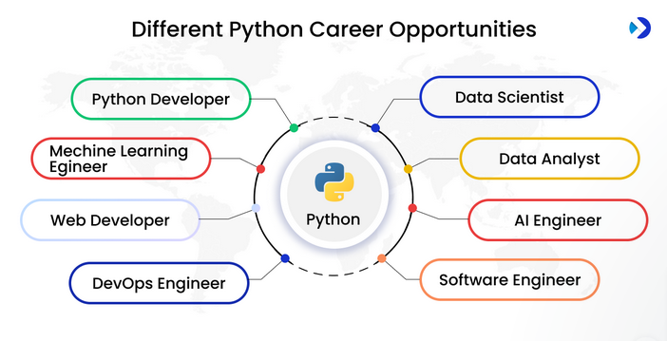

Slide 14
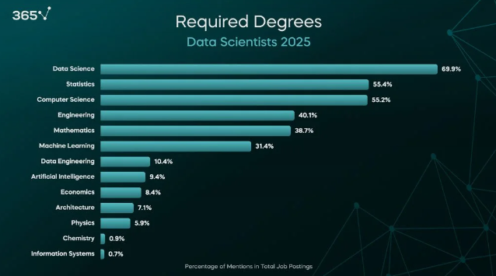

Slide 15


